Slide 1





Object Composition
Closures, Revealing Module Pattern, Object Inheritance, Prototypes
Object Composition
SoftUni Team
Technical Trainers
Software University
http://softuni.bg

Slide 2



Table of Contents
Object Composition
Closures
Module and Revealing Module Patterns
Object Inheritance and Prototype Chain
Objects Interacting with DOM
<number>

Slide 3
Have a Question?
sli.do #JSCORE
<number>

Slide 4

Object Composition in JS
Objects Holding Other Objects

Slide 5
What is Object Composition?
Object composition == combining simple objects or data types into more complex ones
let student = {
firstName: 'Maria',
lastName: 'Green',
age: 22,
location: { lat: 42.698, lng: 23.322 }
}
console.log(student);
console.log(student.location.lat);
<number>

Slide 6
Composing Objects
let name = "Sofia";
let population = 1325744;
let country = "Bulgaria";
let town = { name, population, country };
console.log(town); // Object {name: "Sofia", population: 1325744, country: "Bulgaria"}
Combine variables into object
town.location = { lat: 42.698, lng: 23.322 };
console.log(town); // Object {…, location: Object}
<number>

Slide 7
Combining Data with Functions
let rect = {
width: 10,
height: 4,
grow: function(w, h) {
this.width += w; this.height += h;
},
print: function() {
console.log(`[${this.width} x ${this.height}]`);
}
};
rect.grow(2, 3);
rect.print(); // [12 x 7]
<number>

Slide 8
Printing Objects: toString() Function
let rect = {
width: 10,
height: 4,
toString: function() {
return `rect[${this.width} x ${this.height}]`;
}
};
console.log(rect); // Object {width: 10, height: 4}
// This will invoke toString() to convert the object to String
console.log('' + rect); // rect[12 x 7]
<number>

Slide 9
Problem: Order Rectangles by Size
You are given a set of rectangles (width x height) as nested arrays
Order them by their area, then by width (descending)
[3, 4], [5, 3], [3, 4], [3, 5], [12, 1]
[5, 3], [3, 5], [12, 1], [3, 4], [3, 4]
[2, 2.5], [2.5, 2]
[2.5, 2], [2, 2.5]
<number>

Slide 10
Solution: Order Rectangles by Size
function createRect(width, height) {
let rect = {
width: width,
height: height,
area: () => rect.width * rect.height,
compareTo: function(other) {
let result = other.area() - rect.area();
return result || (other.width - rect.width);
}
};
return rect;
}
<number>

Slide 11
Solution: Order Rectangles by Size (2)
function orderRects(rectsData) {
let rects = [];
for (let [width, height] of rectsData) {
let rect = createRect(width, height);
rects.push(rect);
}
rects.sort((a,b) => a.compareTo(b));
return rects;
}
orderRects([[3, 4], [5, 3], [3, 4], [3, 5], [12, 1]])
Check your solution here: https://judge.softuni.bg/Contests/334
<number>

Slide 12
counter
1
function
function
function
Closures
Enclosing Object State in a Function

Slide 13
What is Closure?
Closure == state maintained (closed) inside a function
Hidden from the outside world
Example: counter with closures
function counterClosure() {
let counter = 0;
function getNextCount() {
console.log(++counter);
};
return getNextCount;
}
let count
counterClosure();
count(); // 1
count(); // 2
count(); // 3
count(); // 4
count(); // 5
<number>

Slide 14
Closures – Shorter Syntax with IIFE
let counter = (function() {
let num = 0;
return function() {
console.log(++num);
};
})();
counter(); // 1
counter(); // 2
counter(); // 3
let counter = (() => {
let num = 0;
return () =>
console.log(++num);
})();
counter(); // 1
counter(); // 2
counter(); // 3
counter(); // 4
<number>

Slide 15
Problem: Fibonacci with Closures
Using closures write a JS function that returns the next Fibonacci number, each time i's called
x12
x5
x4
1
1
2
3
5
8
13
21
34
55
89
144
x3
1
1
2
3
5
1
1
2
3
1
1
2
<number>

Slide 16
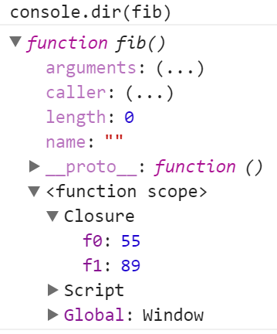
Solution: Fibonacci with Closures
function getFibonator() {
let f0 = 0, f1 = 1;
return function() {
let f2 = f0 + f1;
f0 = f1;
f1 = f2;
return f1;
};
}
let fib = getFibonator();
fib(); // 1
fib(); // 1
fib(); // 2
Check your solution here: https://judge.softuni.bg/Contests/334
<number>

Slide 17
closure
counter
5
function
object
increase()
decrease()
value()
object { }
Module and Revealing Module Patterns

Slide 18
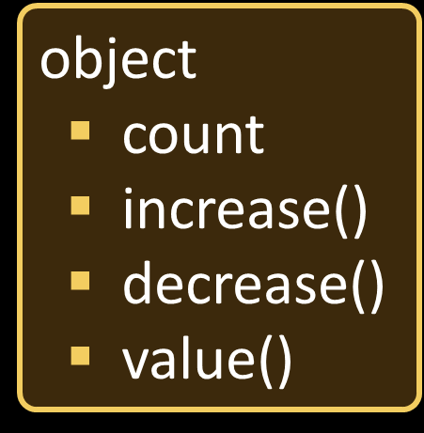
"Module" Pattern (with Object Literal)
let moduleObj = {
count: 0, // public
increase: function(num) { return this.count += num },
decrease: function(num) { return this.count -= num },
value: function() { return this.count }
};
moduleObj.count = 2; // the counter is accessible
console.log(moduleObj.value()); // 2
console.log(moduleObj.increase(5)); // 7
console.log(moduleObj.decrease(1)); // 6
<number>

Slide 19
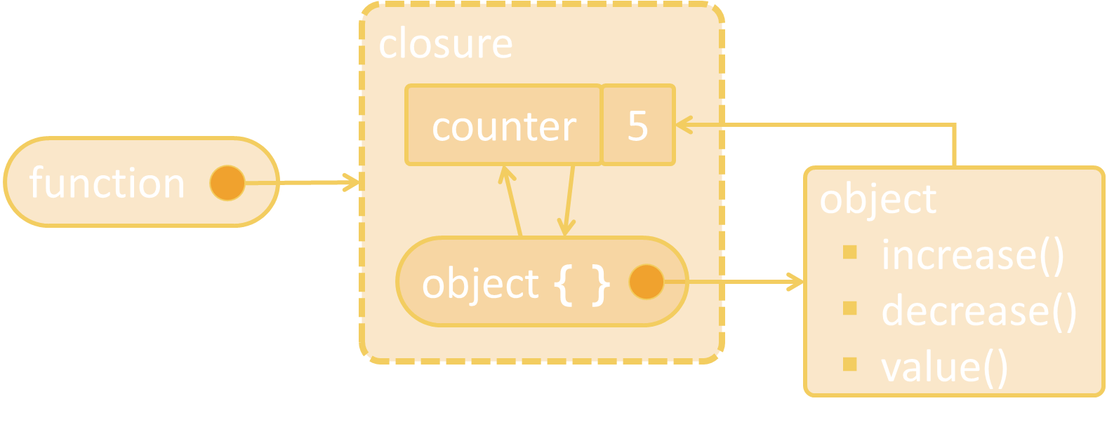
"Module" Pattern (with Closure)
let module = (function() {
let count = 0; // private
return {
increase: (num) => count += num,
decrease: (num) => count -= num,
value: () => count,
};
})();
console.log(module.value()); // 0
console.log(module.increase(5)); // 5
console.log(module.decrease(2)); // 3
console.log(module.count); // undefined (not accessible)
<number>

Slide 20
"Revealing Module" Pattern (with Closure)
let revModule = (function() {
let count = 0; // private
function change(amount) { return count += amount; }
function increase(num) { return change(num); }
function decrease(num) { return change(-num); }
function value() { return count; }
return { increase, decrease, value };
})();
console.log(revModule.value()); // 0
console.log(revModule.increase(5)); // 5
console.log(revModule.decrease(2)); // 3
console.log(module.count); // undefined (not accessible)
<number>

Slide 21
Problem: List Processor
Using a closure (IIFE holding a state inside it) implement a command execution engine to process list commands like shown below
add hello
add again
remove hello
add again
print
hello
hello, again
again
again, again
again, again
again, again
<number>

Slide 22
Solution: List Processor
let commandProcessor = (function() {
let list = [];
return {
add: (newItem) => list.push(newItem),
remove: (item) =>
list = list.filter(x => x != item),
print: () => console.log(list)
}
})();
<number>

Slide 23
Solution: List Processor (2)
function processCommands(commands) {
let commandProcessor = (function(){ … })();
for (let cmd of commands) {
let [cmdName, arg] = cmd.split(' ');
commandProcessor[cmdName](arg);
}
}
processCommands(['add hello', 'add again', 'remove hello', 'add again', 'print']);
Check your solution here: https://judge.softuni.bg/Contests/334
<number>

Slide 24

fatherCar
Object Inheritance
brand
BMW
model
X5
color
blue
myCar
workCar
model
M4
model
i3
color
red
type
electric

Slide 25
Object Inheritance in JS
let fatherCar = { brand: 'BMW',
model: 'X5', color: 'blue',
toString: function() { return `[brand: ${this.brand}, model: ${this.model}, color: ${this.color}]`; }
};
console.log('' + fatherCar);
fatherCar
brand
BMW
model
X5
color
blue
let myCar = Object.create(fatherCar);
myCar.model = 'M4';
myCar.color = 'red';
console.log('' + myCar);
myCar
model
M4
Object.create() inherits an object
color
red
<number>

Slide 26
Object Inheritance in JS (2)
let workCar =
Object.create(fatherCar);
workCar.model = 'i3';
workCar.type = 'electric';
workCar.toString = function() {
return `[brand: ${this.brand}, model: ${this.model}, color: ${this.color}, type: ${this.type}]`;
}
console.log('' + workCar);
fatherCar
brand
BMW
model
X5
color
blue
workCar
model
i3
type
electric
<number>

Slide 27
Prototype Chain
myCar
fatherCar
model
M4
brand
BMW
color
red
Object
model
X5
__proto__
color
blue
__proto__
workCar
model
i3
type
electric
__proto__
<number>

Slide 28
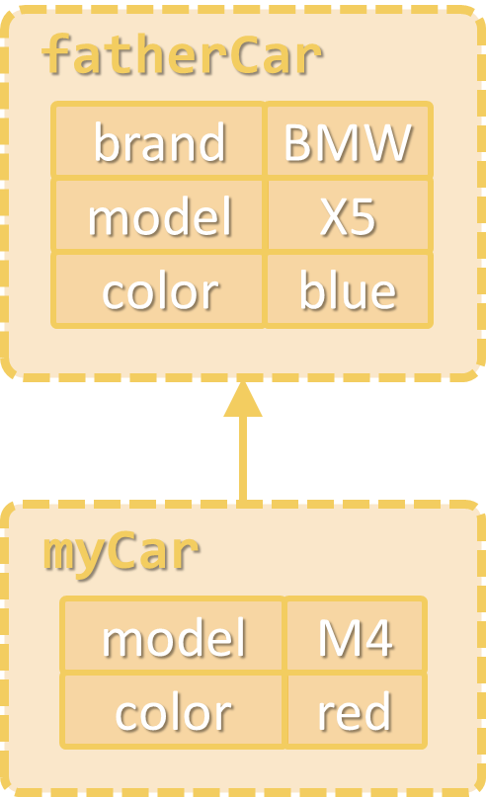
Prototype Chain
Objects have prototype (a parent object)
Prototypes form a prototype chain
If a property is not found in the object itself, it is searched in the parent objects (in the prototype chain)
Object.getPrototypeOf(fatherCar);
// Object {}
Object.getPrototypeOf(myCar);
// Object {brand: "BMW", model: "X5", color: "blue"}
<number>

Slide 29
Problem: Object Inheritance
Write a JS function to execute commands which create, inherit and modify objects:
create c1
create c2 inherit c1
set c1 color red
set c2 model new
print c1
print c2
c1
c1
c2
c1 { color:red}
c2
c1 { color:red}
c2 {model:new}
color:red
model:new, color:red
<number>

Slide 30
Solution: Object Inheritance – Parser
function processCommands(commands) {
let map = new Map();
let cmdExecutor = { … };
for (let command of commands) {
let commandParameters = command.split(' ');
let action = commandParameters.shift();
cmdExecutor[action](commandParameters);
}
}
processCommands(['create c1','create c2 inherit c1'])
c1
c1 {}
map
c2
c2 {}
<number>

Slide 31
Solution: Object Inheritance – Executor
let cmdExecutor = {
create: function ([objName, inherits, parent]) {
parent = parent ? map.get(parent) : null;
let newObj = Object.create(parent);
map.set(objName, newObj);
return newObj;
},
set: function ([objName, key, value]) {
let obj = map.get(objName);
obj[key] = value;
},
print: function ([objName]) {
let obj = map.get(objName), objects = [];
for (let key in obj) { objects.push(`${key}:${obj[key]}`); }
console.log(objects.join(', '));
}
};
Check your solution here: https://judge.softuni.bg/Contests/334
<number>

Slide 32
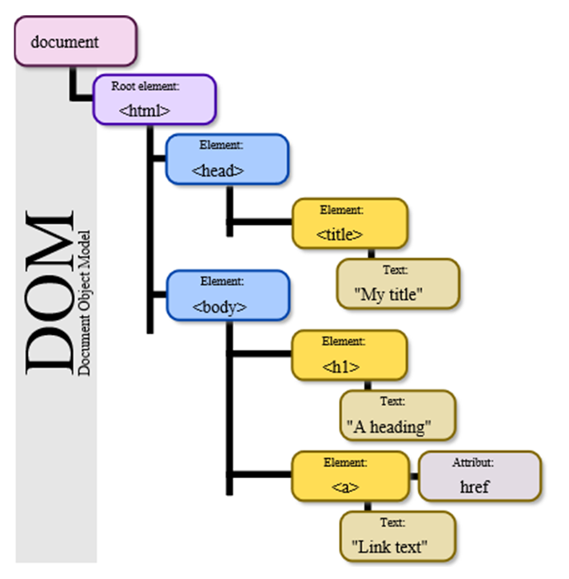
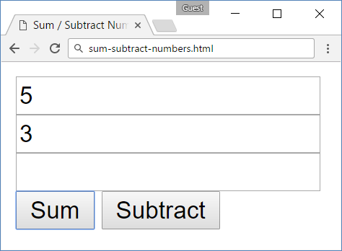
model
init
function
add
function
subtract
function
Objects Interacting with DOM

Slide 33
Problem: Sum / Subtract Numbers
You are given the following HTML form
<input type="text" id="num1" />
<input type="text" id="num2" />
<input type="text" id="result" readonly />
<br>
<button id="sumButton">
Sum</button>
<button id="subtractButton">
Subtract</button>
<number>

Slide 34
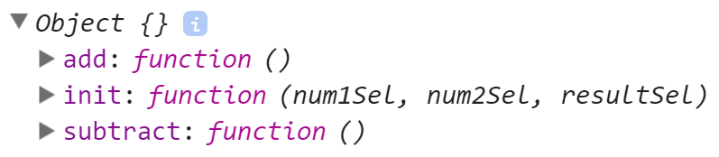
Problem: Sum / Subtract Numbers (2)
Write a JS function getModel() to return a JS object holding
function init(num1Sel, num2Sel, resultSel) → initializes selectors for finding the fields num1, num2 and result in the DOM
function add() → calculates result = num1 + num2
function subtract() → calculates result = num1 - num2
<number>

Slide 35
Problem: Sum / Subtract Numbers (3)
This is how the getModel() function can be used to implement add / subtract operatons in the DOM tree:
$(function() {
let model = getModel();
model.init('#num1', '#num2', '#result');
$('#sumButton').click(model.add);
$('#subtractButton').click(model.subtract);
});
<number>

Slide 36
Solution: Sum / Subtract Numbers
// Solution using the "Module" pattern
function getModel() {
let model = {
init: function(num1Sel, num2Sel, resultSel) {
model.num1 = $(num1Sel);
model.num2 = $(num2Sel);
model.result = $(resultSel);
},
add: () => model.action((a, b) => a + b),
subtract: () => model.action((a, b) => a - b),
<number>
Notes:
© Software University Foundation – http://softuni.org
This work is licensed under the Creative Commons Attribution-NonCommercial-ShareAlike license.
<number>

Slide 37
Solution: Sum / Subtract Numbers (2)
action: function(operation) {
let val1 = Number(model.num1.val());
let val2 = Number(model.num2.val());
model.result.val(operation(val1, val2));
}
};
return model;
}
Check your solution here: https://judge.softuni.bg/Contests/334
<number>
Notes:
© Software University Foundation – http://softuni.org
This work is licensed under the Creative Commons Attribution-NonCommercial-ShareAlike license.
<number>

Slide 38
Another Solution: Sum / Subtract Numbers
// Solution using the "Revealing Module" pattern
function getModel() {
let num1, num2, result;
function init(num1Sel, num2Sel, resultSel) {
num1 = $(num1Sel);
num2 = $(num2Sel);
result = $(resultSel);
}
function add() { action((a, b) => a + b); }
function subtract() { action((a, b) => a - b); }
<number>
Notes:
© Software University Foundation – http://softuni.org
This work is licensed under the Creative Commons Attribution-NonCommercial-ShareAlike license.
<number>

Slide 39
Another Solution: Sum / Subtract Numbers (2)
function action(operation) {
let val1 = Number(num1.val());
let val2 = Number(num2.val());
result.val(operation(val1, val2));
}
let model = { init, add, subtract };
return model;
}
Check your solution here: https://judge.softuni.bg/Contests/334
<number>
Notes:
© Software University Foundation – http://softuni.org
This work is licensed under the Creative Commons Attribution-NonCommercial-ShareAlike license.
<number>

Slide 40

Practice: Object Composition
Live Exercises in Class (Lab)

Slide 41


Summary
Object composition combines data and functions into JS objects
The "Module" pattern hides data into a function and reveals a JS object
The "Revealing Module" pattern hides data and functions are reveals them as JS object
Objects can inherit parent object by Object.create(parent)
let r = {w:5, h:3, grow:function() { … }}
41

Slide 42







Object Composition
https://softuni.bg/courses/
Notes:
© Software University Foundation – http://softuni.org
This work is licensed under the Creative Commons Attribution-NonCommercial-ShareAlike license.
<number>

Slide 43
License
This course (slides, examples, demos, videos, homework, etc.) is licensed under the "Creative Commons Attribution-NonCommercial-ShareAlike 4.0 International" license
<number>
Notes:
© Software University Foundation – http://softuni.org
This work is licensed under the Creative Commons Attribution-NonCommercial-ShareAlike license.
<number>

Slide 44





Free Trainings @ Software University
Software University Foundation – softuni.org
Software University – High-Quality Education, Profession and Job for Software Developers
softuni.bg
Software University @ Facebook
facebook.com/SoftwareUniversity
Software University Forums
forum.softuni.bg
Notes:
© Software University Foundation – http://softuni.org
This work is licensed under the Creative Commons Attribution-NonCommercial-ShareAlike license.
<number>

